Slide 1


D
S
M
DOCUMENT MANAGEMENT SYSTEM

Slide 2



INTRODUCTION
This project focuses on developing a Document Management System (DMS) that enables users to efficiently upload, store, manage, and retrieve digital documents. The system aims to reduce manual paperwork, improve document accessibility, and enhance collaboration within an organization. With features like secure storage, search functionality, and version control, the DMS provides a reliable and scalable solution for managing various types of documents in a centralized digital environment.

Slide 3





OVERVIEW:
Goal: To create a centralized, secure, and efficient system for uploading, managing, and retrieving digital documents.
Frontend Role: Provides a user-friendly interface for users to interact with the system, including document upload, search, view, and download features.
Backend Role: Handles business logic, user authentication (e.g., with JWT), API communication, and controls access to document-related operations.
Database Role: Stores user data, document metadata, and file references using MongoDB, enabling flexible and scalable data management.

Slide 4


FRONTEND:
Core Components
Upload, search, and manage documents
2.Interactive Features
Live upload status and version control
3.State Management
Backend ensures data consistency
4.Responsive Design
Works well on all devices

Slide 5

BACKEND:
Database
MongoDB for flexible, scalable document and metadata storage
Mongoose for schema definition and data validation
API Architecture
RESTful API for client-server communication
CRUD operations for documents and user management
Authentication & Security
JWT-based user authentication
Passwords securely hashed with bcrypt
Middleware for access control and role-based permissions

Slide 6

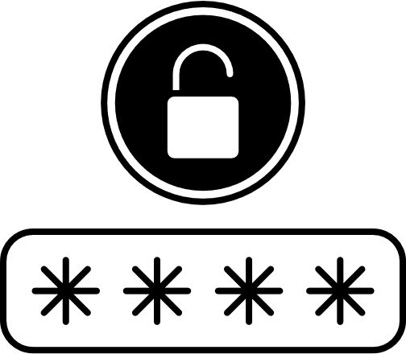
JWT AUTHENTICATION
User Logs In
The user submits credentials (like username and password) to the server.
2.Token Issued
If valid, the server generates a JWT signed with a secret key and returns it to the client.
3.Token Stored Client-Side
The client stores the token (typically in localStorage or sessionStorage).
4.Authenticated Requests
For each request to a protected route, the client sends the JWT in the request headers (usually as Authorization: Bearer <token>).
5.Token Verified
The server validates the token’s signature and payload. If valid, it allows access.

Slide 7
MONGODB:
Flexible Document Storage:
MongoDB stores data in BSON (Binary JSON) format, which is ideal for storing documents with varying structures such as PDFs, Word files, scanned images, and metadata. This flexibility is perfect for managing different types of documents without needing a rigid schema.
2. Schema-less Design:
In a DMS, documents can have different sets of metadata. MongoDB’s schema-less nature allows each document to store its own unique fields, making it easier to accommodate diverse document types without database redesign.
3. High Performance:
MongoDB offers fast read and write operations, which is essential for real-time uploading, retrieving, and searching documents in a DMS.

Slide 8


CONCLUSION:
The Document Management System (DMS) provides a structured and efficient method for storing, organizing, retrieving, and securing digital documents. It reduces dependency on paper, enhances collaboration, and ensures quick access to information, thereby improving overall organizational productivity. By implementing features such as version control, access permissions, and secure storage, the system helps maintain data integrity and confidentiality. The DMS proves to be a scalable and adaptable solution across various industries including education, healthcare, legal, and corporate sectors.
Future work:
AI Integration: Incorporating AI and machine learning for smart document categorization, metadata extraction, and predictive search capabilities.
Cloud-Based DMS: Expanding to cloud infrastructure for greater accessibility, collaboration, and scalability.
Blockchain for Security: Using blockchain to ensure document authenticity, transparency, and tamper-proof records.

Slide 9

THANK YOU

